Slide 1
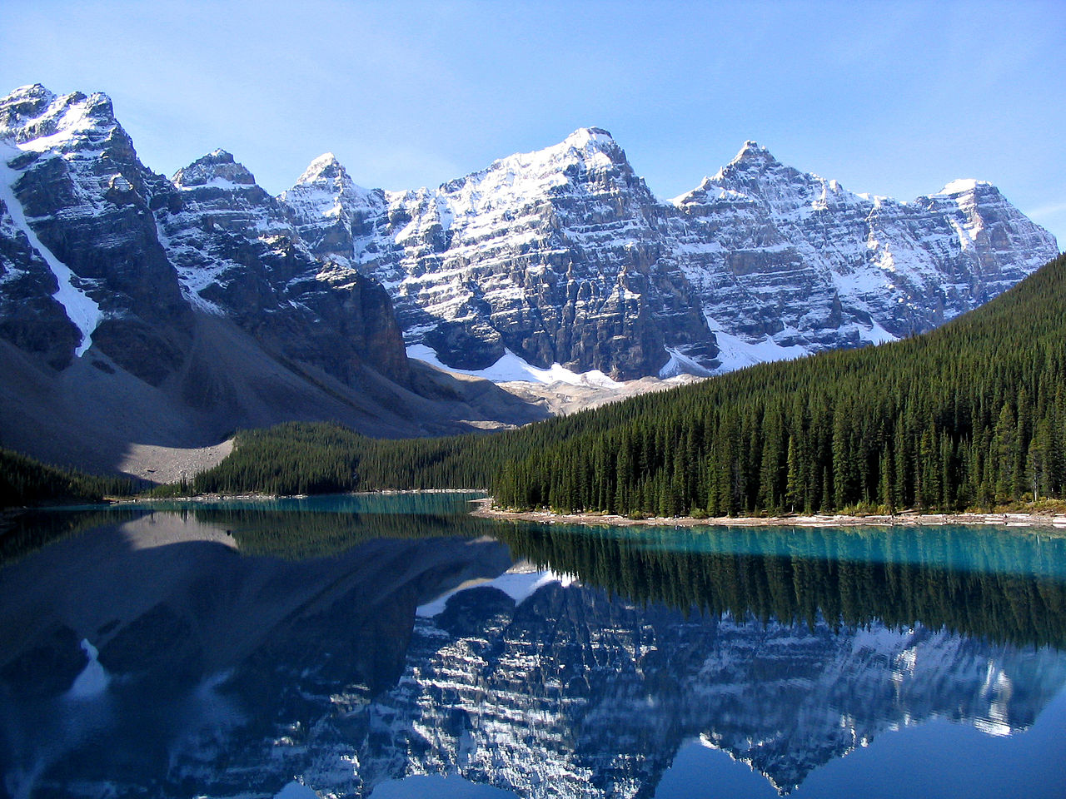
Biodiversity for the National Parks
By Marco Di Stefano

Slide 2
Species_Info.CSV
Dataset contains info about several different species in National Parks
Notably conservation status and species category
Conservation status breaks down into
Species of Concern: declining population or appears to be in need of conservation.
Threatened: vulnerable to endangerment in the near future.
Endangered: seriously at risk of extinction.
In Recovery: formerly Endangered, but currently not in danger of extinction throughout all or a significant portion of its inhabitable range.

Slide 3
Species_Info.CSV
Category refers to the group of species.
Amphibian
Bird
Fish
Mammal
Nonvascular Plant
Reptile
Vascular Plant

Slide 4
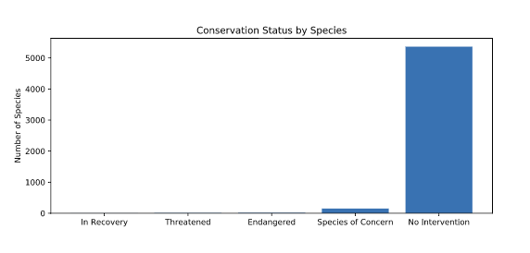
Should we be worried?
Thankfully, majority of Species in the data set require no intervention at any level.
However a total of 180 species need to be monitored. The break down of severity is
Status Number of species
Endangered 15
In Recovery 4
Species of Concern 151
Threatened 10

Slide 5
Is one species more likely to be endangered than another?
Certain categories have more protected numbers to others.
Birds are the Highest number of species that are protected, while Mammals have the highest % of protected
Just because these two are more common in the data set, doesn't mean they are more likley
category | not_protected | protected | percent_protected
Amphibian | 73 | 7 | 8.75%
Bird | 442 | 79 | 15.16%
Fish | 116 | 11 | 8.66%
Mammal | 176 | 38 | 17.76%
Nonvascular | 328 | 5 | 1.50%
Reptile | 74 | 5 | 6.33%
Vascular | 4424 | 46 | 1.03%

Slide 6
Are Mammals more likely to be protected than Birds?
A Chi Square test will tell us if there is a significant difference
(something worth looking into)
Null Hypothesis = is that this difference is due to chance
Pvalue = 0.688 which is greater than 0.05
Therefore Mammals are not more likely protected that Birds and is due to chance

Slide 7
What about between reptiles and mammals
Null Hypothesis = is that this difference is due to chance
Pvalue = 0.038 which is less than 0.05
Therefore we reject the Null Hypothesis (this is significant)
Therefore some species are more likely to be protected!

Slide 8
Recommendations
Next steps would be to ask which animals are more likely and why?
Look for trends such as if conservation status changes at certain parks than others?
Investigate what are reasons for one species to be more endangered?
Are they hunted more?
Are they not able to to adapt to the current planet as well?
Are they a result of their main prey being endangered?

Slide 9
Foot and Mouth Reduction Effort - Sample Size Determination
Determine a sample size to test if a program is working or not
Minimum detectable effect :detect reductions of at least 5 percentage point
Baseline :15% of sheep at Bryce National Park have foot and mouth disease
Using a 90% significance we determine we need a sample size of 510 sheep to check if they have Foot and Mouth.
Given the current sighting rates, it would take 1 full week at yellowstone or 2 weeks at Bryce to obtain enough samples

Slide 10
Note
Code was written in the learning environment on codecademy.com

